Slide 1
Leveraging Communities to Highlight Scholarly Repository Content

Slide 2


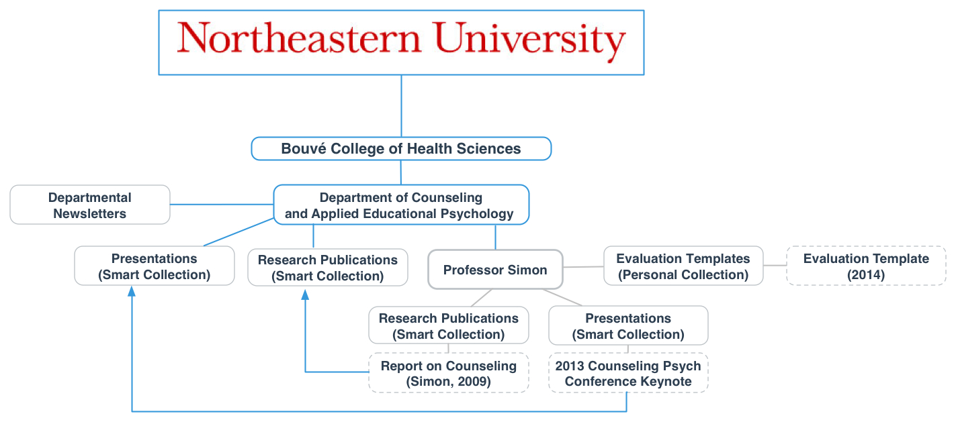
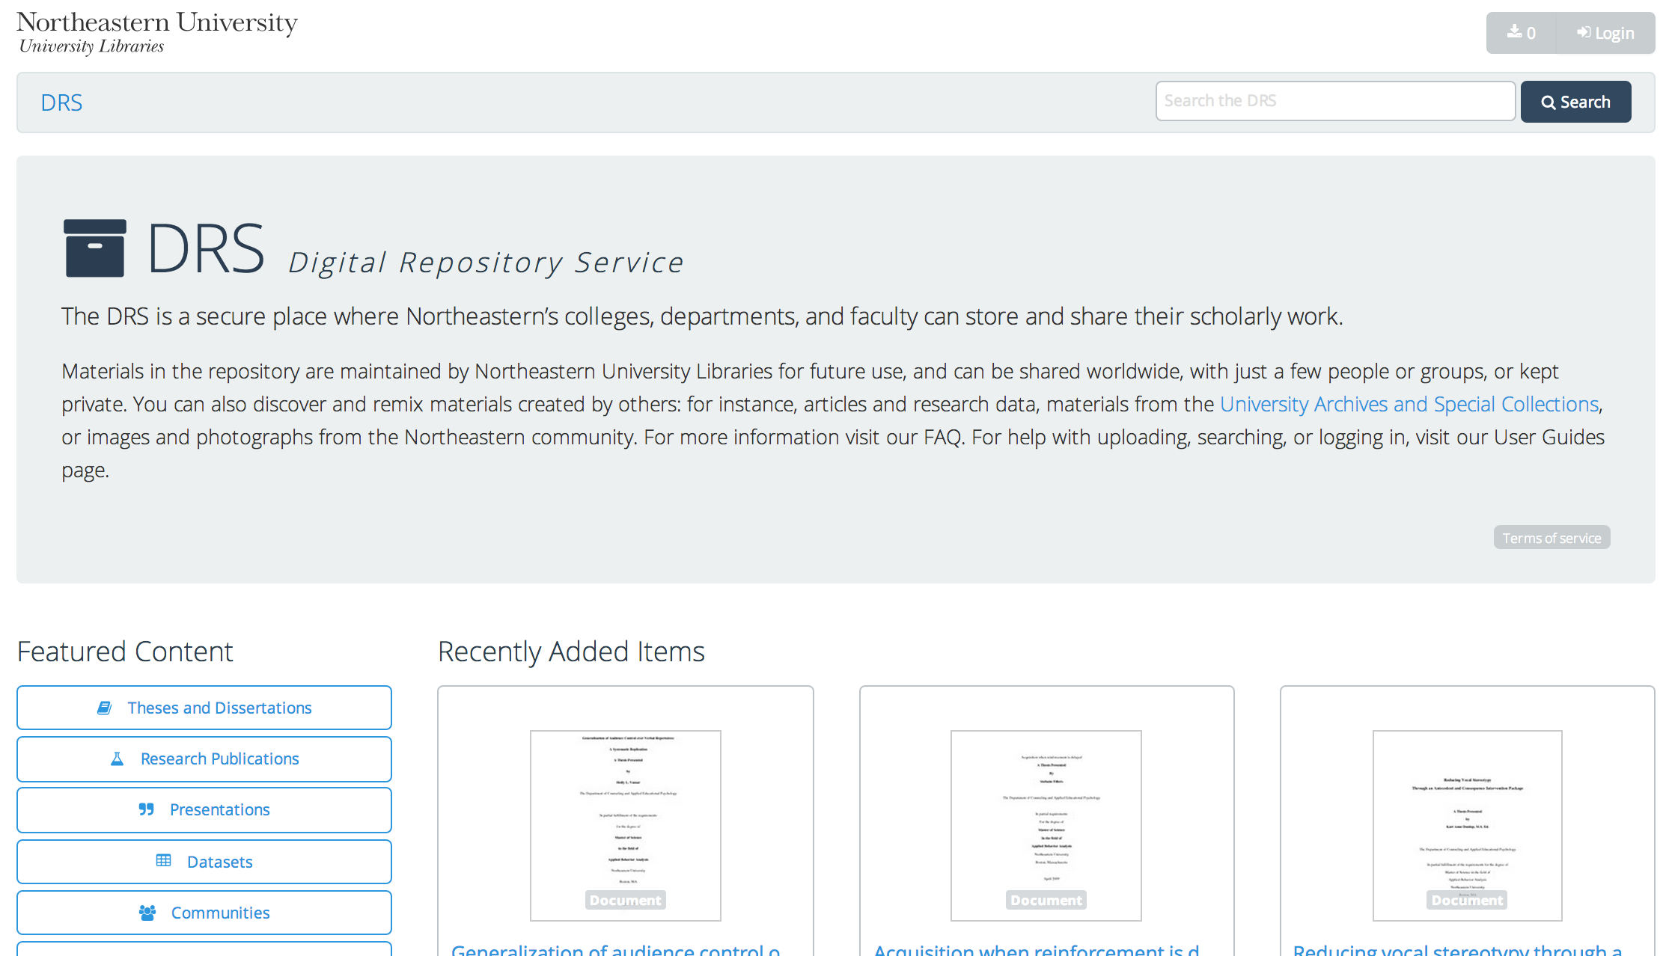
Leveraging Communities to Highlight Scholarly Content
Text text text text Text text text text Text text text text Text text text text Text text text text Text
https://repository.library.northeastern.edu

Slide 3
Fall/Winter Review
Soft Launch
DRS Training
Usability Testing
Handout Materials
URL Change:
https://repository.library.northeastern.edu

